Slide 1
Express.js
3APIS

Slide 2
3APIS – Express.js
Course Objectives
By the end of the course, students should:
Learn about Express.js
Know how to create an HTTP server
Be able to handle multiple routes
Be capable to build complex APIs

Slide 3
Summary
Express.js
Routing
Middleware

Slide 4
1. Express.js

Slide 5
1. Express.js
Express.js, commonly known as Express, stands out as a minimal and flexible web application framework for Node.js.
It simplifies the process of building robust and scalable web applications by providing a set of essential features and tools.
Designed to work seamlessly with Node.js, Express enhances the server-side development experience, allowing developers to focus on creating dynamic and feature-rich applications.

Slide 6
1. Express.js
Express.js is widely adopted for various web development projects, ranging from small-scale applications to large-scale enterprise solutions.
Its popularity stems from its lightweight nature, flexibility, and the ease with which developers can scaffold and build RESTful APIs and web applications.

Slide 7
1. Express.js
Express.js was created by TJ Holowaychuk. Holowaychuk, a prolific developer known for his contributions to the Node.js ecosystem, crafted Express with the vision of simplifying and streamlining the process of building web applications atop Node.js.
Express.js had its initial release in 2010. TJ Holowaychuk designed it to be a minimalist yet powerful framework, providing developers with essential tools to expedite the development of web applications and APIs.
Holowaychuk's work on Express marked a significant departure from more monolithic web frameworks. Express embraced a modular and minimalist approach, enabling developers to choose and incorporate specific components based on their project requirements.

Slide 8
1. Express.js
The first release, according to Express.js's GitHub repository, was on the 22nd of May, 2010. Version 0.12
In June 2014, rights to manage the project were acquired by StrongLoop. StrongLoop was acquired by IBM in September 2015
In January 2016, IBM announced that it would place Express.js under the stewardship of the Node.js Foundation incubator.

Slide 9
1. Express.js
Based on top of Express.js, multiple stack were created to encompass the size of large project, using an acronym to refer to a group of tools
Mongo
Express.js
React or Angular
Node.js
This terms are less used today, but were standards between 2014 to 2019.

Slide 10
1. Express.js
The MERN stack, a powerful full-stack JavaScript framework, encompasses MongoDB, Express.js, React, and Node.js.
MongoDB serves as the NoSQL database, allowing for flexible and scalable data storage.
Express.js, a minimalist web application framework for Node.js, streamlines server-side development with efficient routing and middleware management.
React, a declarative JavaScript library, facilitates the creation of dynamic and interactive user interfaces.
Node.js, as the JavaScript runtime, enables the execution of server-side code.
Together, the MERN stack provides a cohesive and end-to-end JavaScript solution for developing modern and feature-rich web applications.

Slide 11
1. Express.js
The MEAN stack shares the philosophy of full-stack JavaScript development and consists of MongoDB, Express.js, Angular, and Node.js.
MongoDB serves as the NoSQL database, offering flexibility in handling unstructured data.
Express.js, the web application framework for Node.js, provides a solid foundation for server-side development.
Angular, a TypeScript-based front-end framework, simplifies the creation of dynamic single-page applications with a modular structure.
Node.js, as the runtime for server-side JavaScript, ensures a unified language across the entire stack.
The MEAN stack exemplifies the efficiency and integration of JavaScript throughout the development process, catering to various project requirements and developer preferences.

Slide 12
1. Express.js
Even with less update today, Express stays strong and is still the Node.js framework the most downloaded.
To be precise he got more download weekly than all other backend framework combined and added to React or the same number of download as the combined values for Angular, React and Vue.js.
The strength is based on key features of Express.js

Slide 13
1. Express.js
Routing
Express simplifies URL routing, allowing developers to define routes for handling different HTTP methods and requests.
This streamlined routing mechanism enhances the organization and structure of the application.

Slide 14
1. Express.js
Middleware
Middleware functions in Express play a crucial role in processing requests.
Developers can use existing middleware or create custom middleware to execute specific tasks, such as authentication, logging, or data parsing, before reaching the route handler.

Slide 15
1. Express.js
Templating engines
Express supports various templating engines, including EJS and Pug (formerly Jade), allowing developers to dynamically generate HTML on the server side.
This flexibility aids in rendering dynamic content and building views.

Slide 16
1. Express.js
HTTP utility methods
Express provides utility methods for simplifying common HTTP tasks.
These methods facilitate handling requests, responses, and parameters, streamlining the development process.

Slide 17
1. Express.js
Middleware ecosystem
Express boasts a rich ecosystem of middleware modules available via npm.
This allows developers to easily integrate additional functionality into their applications, ranging from authentication middleware to logging and compression.

Slide 18
1. Express.js
Static file serving
Express simplifies the serving of static files, such as images, stylesheets, and client-side JavaScript.
This is achieved through the express.static middleware, making it convenient to include assets in web applications.

Slide 19
1. Express.js
Error handling
Express provides robust error-handling mechanisms, making it easier for developers to manage and respond to errors in a consistent manner.
Custom error-handling middleware can be implemented to address specific application needs.

Slide 20
1. Express.js
Express.js is widely adopted for various web development projects, ranging from small-scale applications to large-scale enterprise solutions.
Its popularity stems from its lightweight nature, flexibility, and the ease with which developers can scaffold and build RESTful APIs and web applications.

Slide 21
1. Express.js
As a minimalist framework Express is really easy and simple to setup.
First you need to install the package in your project

Slide 22
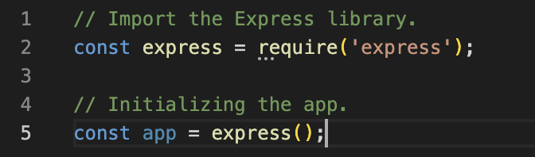
1. Express.js
In a second step you have to require / import the express framework and initialize the application with it
The previous lines represent the express application
Just your HttpServer...
Enriched with express properties & functions!

Slide 23
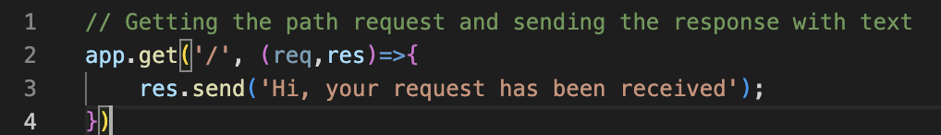
1. Express.js
The next line represent the definition of a route of our application. This is the router of an express application, we will see that in more details a bit later.
What is important here is that we create and listen an endpoint on the url “/” with the method get

Slide 24
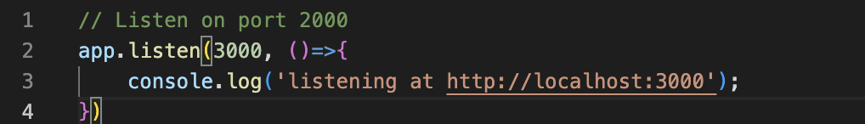
1. Express.js
Finally the last line is here to setup our application to listen on the port 3000.
Without that your application won't be reachable !

Slide 25
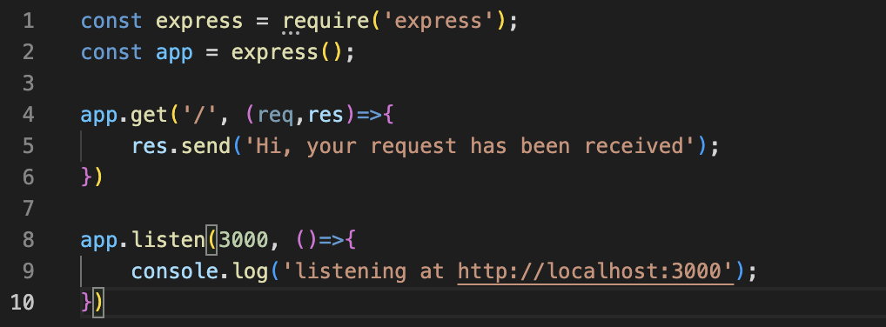
1. Express.js
This should give you the following file

Slide 26
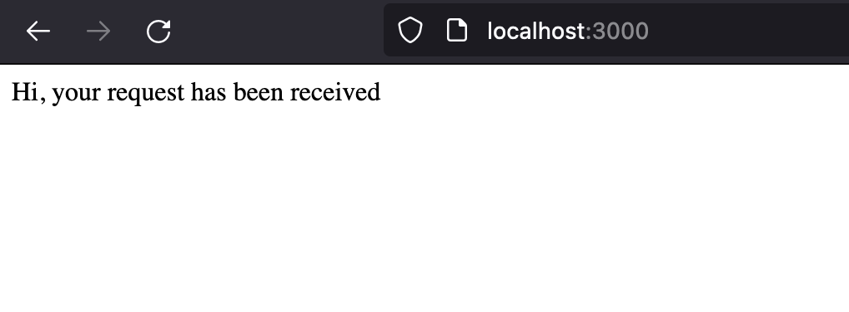
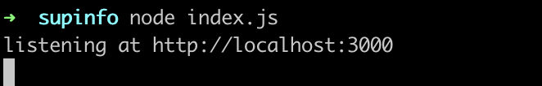
1. Express.js
Simply run it with node index.js and try to access the endpoint with your browser - or using a tool to request the page.
The url is localhost:3000 (if you are using the same setup as presented).

Slide 27
1. Express.js
We will be building API during this class. Most of them offers to return only data with a json format.
Express allow you to return a valid JSON object with the method json() in place of the send(). Try to change it and check what is changing when you query the endpoint.

Slide 28

Exercises

Slide 29
2. Routing

Slide 30
2. Routing
Express catches requests depending on:
HTTP Verbs
URLs
And use a callback to process logic

Slide 31
2. Routing
Without Express you would be stuck writing a long list of conditional JavaScript code.
You would have to write all conditions with a succession of switch or if/else. This would be quite tedious to do so and that is why Express simplify the writing.

Slide 32
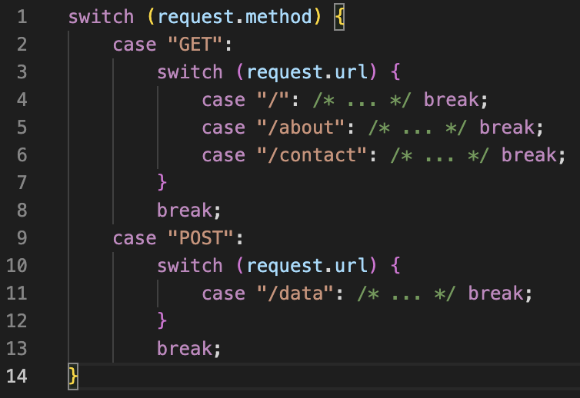
2. Routing
The result should be close to that. Not pretty isn’t it ?

Slide 33
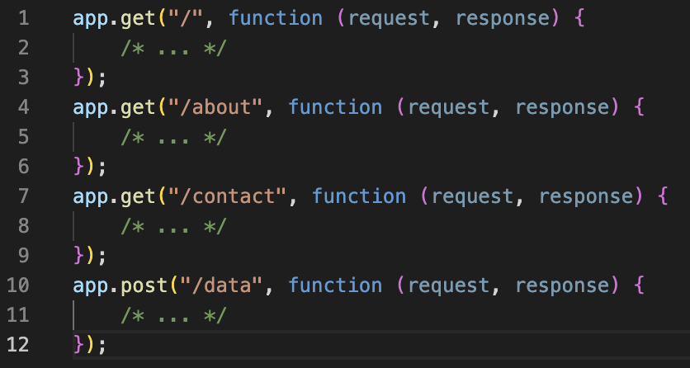
2. Routing
With Express, you just have to write your endpoint and you are good to go !

Slide 34
2. Routing
Of course, all verbs are handled
from the standard GET / POST
to the least used like PUT / PATCH
or even the OPTION
You can use this solution to catch all incoming request. Also another custom verb is used in Express “all”.
The all verb is used by Express to signal to the router that you want to
process all requests independently from the verb used. This is useful as a catch-all solution.

Slide 35
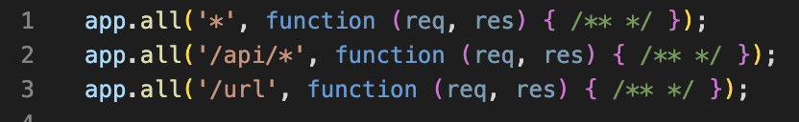
2. Routing
Catch all requests verbs on a pattern

Slide 36
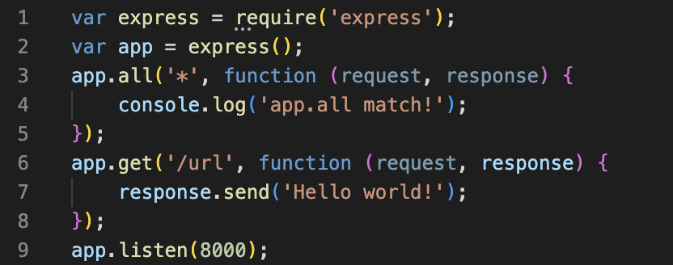
2. Routing
Question: what will be the output when going to /url ?

Slide 37
2. Routing
It won’t send anything to the client!
Only write “app.all match!” in the server console
First route (app.all) matched the request
Therefore other are ignored!
So how do you pass a request on to the next routes?

Slide 38
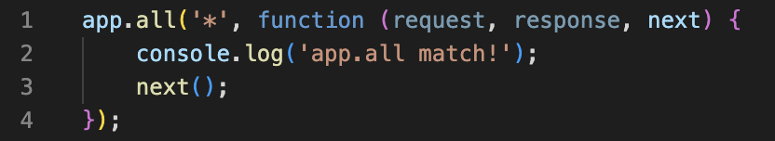
2. Routing
The third parameter in the callback is called "next"

Slide 39
2. Routing
As you can see routing in Express is really easy. Two things you have to
remember.
The first parameter in the callback (request) contains all information linked to the request, including
the query params
the body
the params

Slide 40
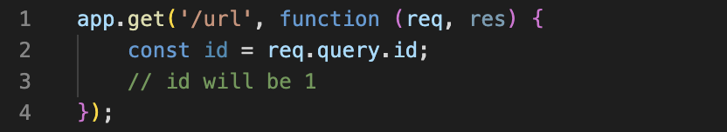
2. Routing
For example if you want to access the query param of a request you can do it by accessing the value of the key inside the query parsed in the request.
If you call your API with “localhost:3000/url?id=1”

Slide 41
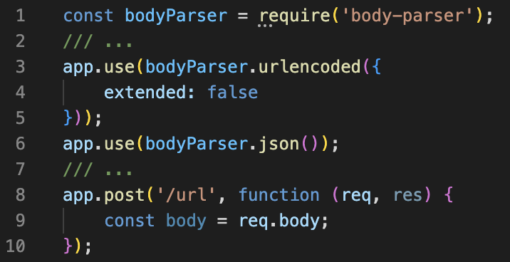
2. Routing
To access the content of the body you will need a package. Multiples exists but the principal used is body-parser

Slide 42
2. Routing
The content of the body will be the whole object send in the request
For more information on body-parser you can check the documentation on the Express.js website
You should be able to find recipes, guides and other documentation for your usage of Express, but also the main middlewares (or packages).

Slide 43
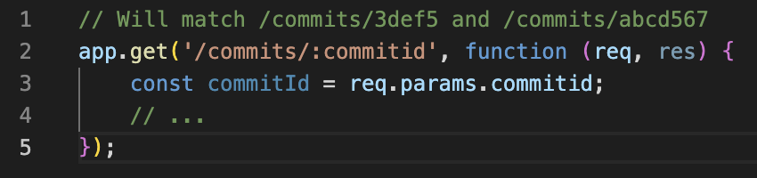
2. Routing
Finally if you want to handle params in the url you will need to use the “:” character.

Slide 44
Exercises

Slide 45
3. Middleware

Slide 46
3. Middleware
Middleware in Express.js is a crucial concept that plays a pivotal role in enhancing the request-response lifecycle within a web application.
Middleware functions are essentially functions that have access to the request object (req), the response object (res), and the next middleware function in the application's request-response cycle (next).
These functions have the ability to perform tasks, modify the request and response objects, end the request-response cycle, and call the next middleware in the stack.

Slide 47
3. Middleware
Express.js middleware functions are invoked in the order they are added to the application.
They can be utilized for a variety of purposes, including logging, authentication, error handling, and more.
Middleware functions are defined with the signature (req, res, next).

Slide 48
3. Middleware
Order of Execution
Middleware functions are executed in the order they are added to the application.
This sequential execution allows for the establishment of a pipeline through which the request and response pass.

Slide 49
3. Middleware
Request and Response Manipulation
Middleware functions can inspect and manipulate both the request and response objects.
This enables tasks such as modifying request headers, parsing request bodies, adding data to the response, and more.

Slide 50
3. Middleware
next Function
The next function is a crucial element in middleware.
When called, it passes control to the next middleware function in the stack.
If omitted, the request-response cycle may be halted, preventing subsequent middleware from executing.

Slide 51
3. Middleware
Middleware Stack
Express maintains a stack of middleware functions that are executed in sequence.
Developers can add middleware globally to the application or locally to specific routes, allowing for fine-grained control over when and how middleware is applied.

Slide 52
3. Middleware
Built-in and Third-Party Middleware
Express provides a set of built-in middleware functions for common tasks such as serving static files, handling cookies, and parsing the request body.
Additionally, developers can leverage third-party middleware or create custom middleware tailored to the application's specific needs.

Slide 53
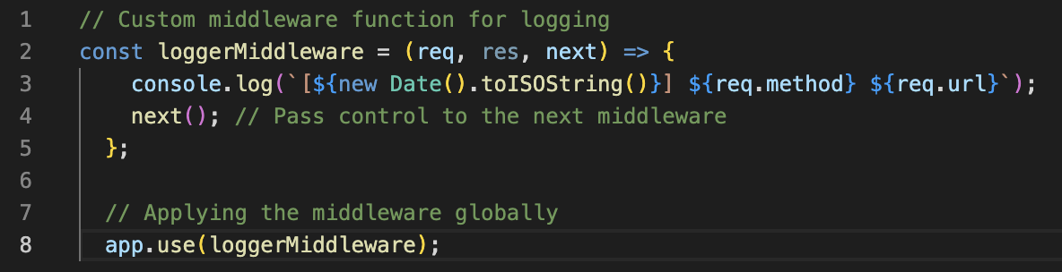
3. Middleware
Example of a middleware:

Slide 54
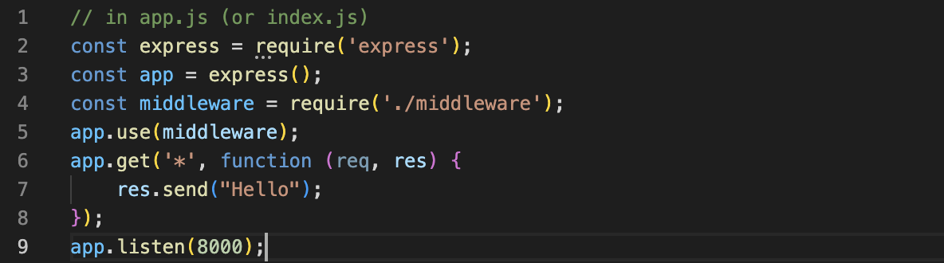
3. Middleware

Slide 55
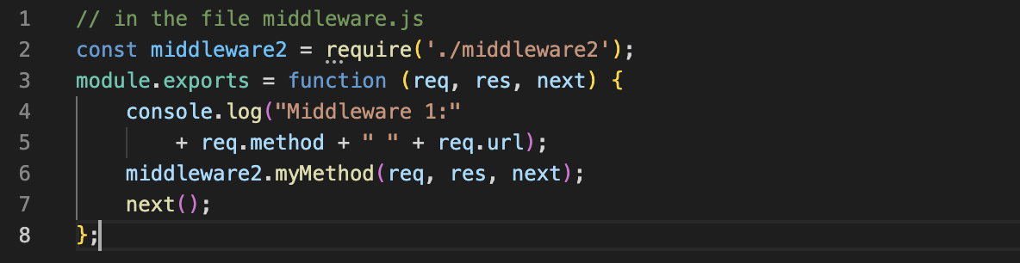
3. Middleware

Slide 56
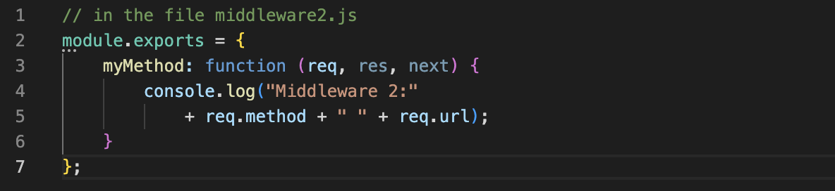
3. Middleware

Slide 57
3. Middleware
Lot of third-party middlewares
Use them to add features to your application
Find a list at this URL
And remember: Make it modular!

Slide 58
Exercises

